Slide 1
Predicting the marketing strategy of e-commerce products based on text big data
Members:
Ding Lichao
Hu Zijiao
2021.10.16

Slide 2
CONTENTS
1
Introduction
2
Assumption
3
Data acquisition&
Data Clean
4
Naive Bayes Model

Slide 3
1
Introduction

Slide 4

A brief introduction of our project
1
In the online marketplace, most electronic business platforms provide customers with opportunities to rate and review purchases.The Review and Rating System has been playing a huge role during the evolution of E-commerce. Customers use it to help make the best purchase decisions, while vendors can utilize it to collect opinions on how to make improvements.
Therefore, it is of essential to extract the most valuable information out of mountains of customers’ voices.

Slide 5
2
Assumption

Slide 6
Assumption
2
●Assumption 1. The online marketplace operates stably. And there were no situations such as an out_x0002_break of an epidemic which would seriously affect the production chain of online shopping.
●Assumption 2. The ratings and reviews depict customers’ real experience and feeling about their purchased products. The sentiment in the review text reflects one’s feelings on the products.
●Assumption 3. The vast majority of individual differences of customers e.g., economic status and educational level, are ignored.

Slide 7
Assumption
2
●Assumption 4. It takes some time for shipping the product. Some customers would prefer making reviews sometime after receiving the purchased products.
●Assumption 5. Consumers pay more attention to the negative comments e.g., low-star rating or negative reviews when purchasing the products.
●Assumption 6.The influence of word order in semantic analysis is ignored, and the influence of word order on overall emotion is not considered when analyzing and commenting feelings. That is, we assume that "I love this hair Dryer "and" The hair Dryer Love Me "have the same emotional color.

Slide 8
3
Data acquisition&
Data Clean

Slide 9
Data acquisition & Data Clean
3
Based on customers can submit these:
1.Individual ratings
Allow purchasers to express their level of satisfaction with a product using a scale of 1 (low rated, low satisfaction) to 5 (highly rated, high satisfaction).
2.Text-based messages
Reviews that express further opinions and information about the product.
3.Helpfulness rating
Ratings on these reviews as being helpful or not , towards assisting their own product purchasing decision.

Slide 10
Data acquisition & Data Clean
3
The data set contains the following:
●marketplace（string）
●customer_id（string）
●review_id（string）
●product_id（string）
●product_parent（string）
●product_title（string）
●product_category（string）
●star_rating（int）
●helpful_votes（int）
●total_votes（int）
●vine（string）
●verified_purchase（string）
●review_headline（string）
●review_body（string）
●review_date（bigint）

Slide 11
Data acquisition & Data Clean
3
Data Clean
We need to:
●Delete reviewers didn’t buy the products actually.
●Delete the column of marketplace and product_category.
●Rearrange index.
Then we will get three new data set after cleaning.

Slide 12
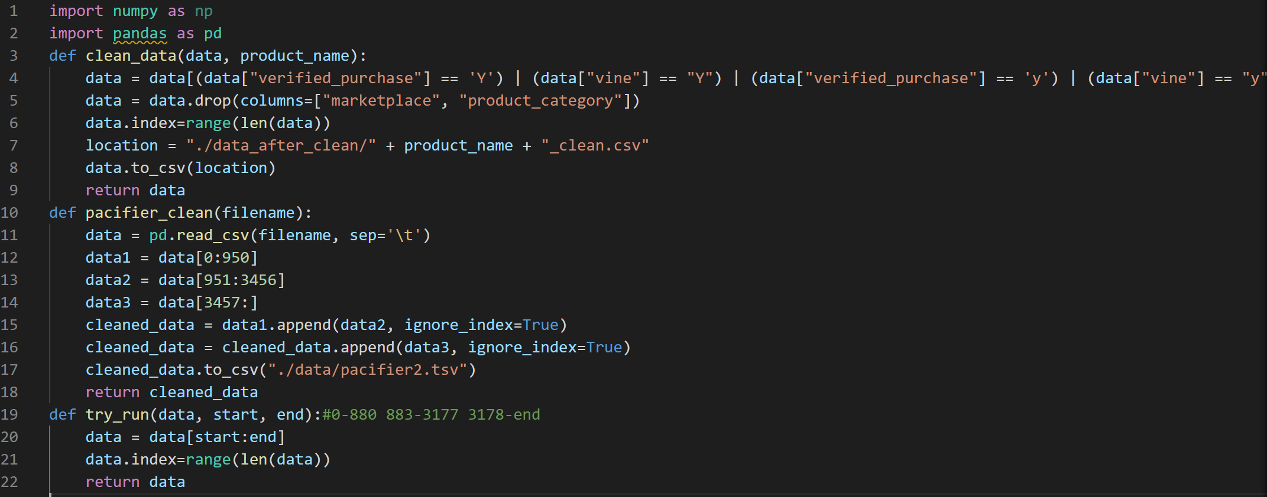
Data acquisition & Data Clean
3
Essential Code：

Slide 13
4
Naive Bayes Model

Slide 14
Naive Bayes Model
4
In order to extract information about product from user reviews, we need to use Natural Language Processing (NLP) to extract emotionally relevant words in the reviews, and judge the user's emotional tendencies from these words, and further quantify the content of the reviews. We will use this quantified value as a measure of user satisfaction.
First of all, we want to get the goal that we can predict the positive or negative probability of the emotion of a review through a word in the review, so as to determine whether the review is positive or negative. In the field of Natural Language Processing (NLP), Naive Bayes is usually used to Text-Categorization, and it is direct and efficient when dealing with problems. Therefore, we use Naive Bayes to classify user reviews.

Slide 15
Naive Bayes Model
4
In order to extract information about product from user reviews, we need to use Natural Language Processing (NLP) to extract emotionally relevant words in the reviews, and judge the user's emotional tendencies from these words, and further quantify the content of the reviews. We will use this quantified value as a measure of user satisfaction.
First of all, we want to get the goal that we can predict the positive or negative probability of the emotion of a review through a word in the review, so as to determine whether the review is positive or negative. In the field of Natural Language Processing (NLP), Naive Bayes is usually used to Text-Categorization, and it is direct and efficient when dealing with problems. Therefore, we use Naive Bayes to classify user reviews.

Slide 16
Naive Bayes Model
4
When the Naive Bayes method classifies words into emotions, the learned model is used to calculate the posterior probability distribution of the input word x, and the class with the greatest posterior probability is used as the class output of the input word x.
Suppose x ∈ X, X is a collection of review words, ck ∈ Y, Y = {Pos,Neg} represents both positive and negative comments.Y = 1 represents this review as a positive comment, while Y = 0 represents this review as a negative review.Then we need to get its posterior probability P(Y = ck|X = x),
According to Bayes formula,we have:
P(Y = ck|X = x) = P(X = x|Y = ck)P(Y = ck) /(∑k P(X = x|Y = ck)P(Y = ck) )

Slide 17
Naive Bayes Model
4
Because
∑k P(X = x|Y = ck)P(Y = ck) =
P(X = x|Y = Pos)P(Y = Pos)+P(X = x|Y = Neg)P(Y = Neg)
is a fixed value,the problem we solved becomes the following optimization problem:
y = argmaxckP(Y = ck)P(Y = ck)P(X = x|Y = ck)
Among them, y ∈ Y is the category with the greatest posterior probability of x,We output this category as the category of the word. We find a labeled corpus of Amazon reviews on the kaggle website as a training set to train our Bayesian classifier, and then use it to analyze the sentiment tendency of reviews.

Slide 18
Thank you for listening
Members:
Di Lichao
Hu Zijiao

